Slide 1

Module 6
Arrays, Lists, and Iteration

Slide 2
Learning Objectives
Build a console app that creates an array object and reads from and writes to elements of the array
Build a console app that creates a list object and reads from and writes to elements of the list
Build a console app that processes a list using a for loop
Build a console app that processes a list using a foreach loop
Build a console app that imports a DLL (Dynamic Link Library)
Build a console app that uses while loops for input validation
Build a console app that uses a while loop to decide when to quit

Slide 3
Arrays, Lists

Slide 4
Content (slot 1)
Declaring and Creating Array Objects
Accessing Elements of the Array
Arrays of Objects
Refactoring the Card Class
Exercise 21
Multi-Dimensional Arrays
Collection Classes
Putting It All Together
Exercise 22
Common Mistakes

Slide 5
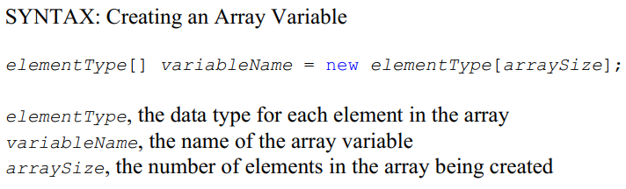
6.1 Declaring and Creating Array Objects
Example: Storing GPAs for 10 students

Slide 6
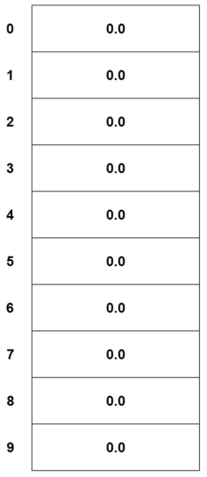
6.1 Declaring and Creating Array Objects
Pictorial Representation of gpas

Slide 7
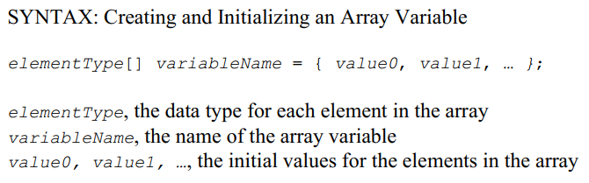
6.1 Declaring and Creating Array Objects

Slide 8
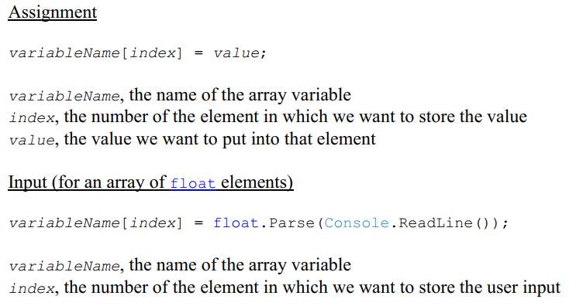
6.1 Accessing Elements of the Array

Slide 9
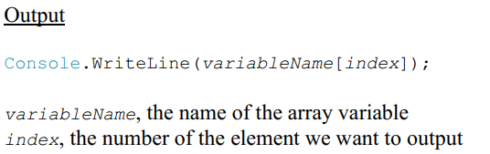
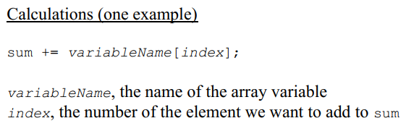
6.2 Accessing Elements of the Array

Slide 10
6.2 Accessing Elements of the Array
Example:
to set the first element of the gpas array to 4.0
to print out the 8th element of the gpas array
to add the last element in the gpas to a variable called sum

Slide 11

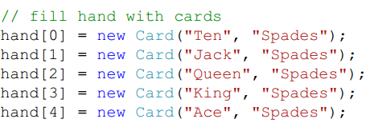
6.3 Arrays of Objects
build an array containing 5 Card objects (remember the Card class from the Classes and Objects module):
This will create an array of 5 elements, each of which will be a Card object.
At this point, each element in the array is null because that's what reference types get for their initial value.
fill the array with some really good cards

Slide 12

6.3 Arrays of Objects
How do you access a property or call a method for one of the array elements? For example, how would we print the Rank and Suit properties of the third card in the array?
To access the Rank property for the third card in the array using
To print the rank and suit of the third card in the array using

Slide 13
6.4 Refactoring the Card Class
Refactoring means changing the structure of the code with the goal of making it faster or easier to understand.
When we developed the Card class in module 3, we didn't know about enumerations yet; that's why we used string for the rank and suit of the card.
But we know better now, so it's time to refactor.

Slide 14

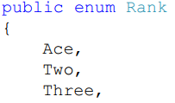
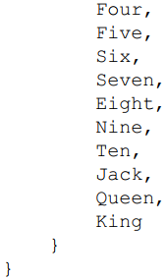
6.4 Refactoring the Card Class
Define two enumerations (Rank and Suit) for use in our Card class

Slide 15
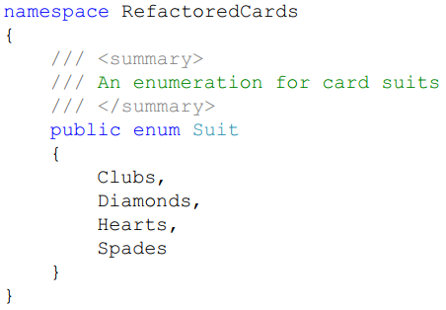
6.4 Refactoring the Card Class

Slide 16

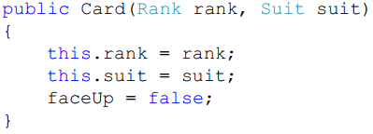


6.4 Refactoring the Card Class
Change the Card class to use those enumerations instead of string.

Slide 17
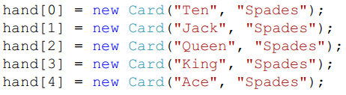
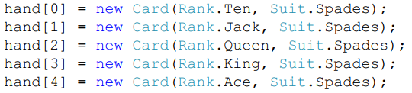
6.4 Refactoring the Card Class
need to change to

Slide 18
Exercise 21: Arrays
View LMS

Slide 19

6.5 Multi-Dimensional Arrays
Declare a two-dimensional array:
Access elements of this array using the general form
We're not limited to two-dimensional arrays either; we can essentially use as many array dimensions as we want.

Slide 20
6.6 Collection Classes
Arrays are very useful for storing multiple values that are all the same data type, but there is one significant limitation.
We have to know the maximum number of elements that will be in the array when we create the array object using new.
➔ If the array is only partially filled, for example, we need to keep track of how many elements are currently in the array so we know where to add the next element in the array.
➔If we end up filling the array and needing more space because we misjudged how many elements we'd need to store, we'd need to create a new (larger) array and copy all the elements from the old array to the new one.

Slide 21
6.6 Collection Classes
C# provides a set of built-in collection classes that help solve this problem. Basically, these classes let us store a collection of elements, and they also provide lots of useful properties and methods for manipulating those collections.
System.Collections.Generic and System.Collections namespace.
The List class is called a generic class because it's generic enough to hold elements of any type you want.
Have to specify what that type is when you create the new List object.

Slide 22
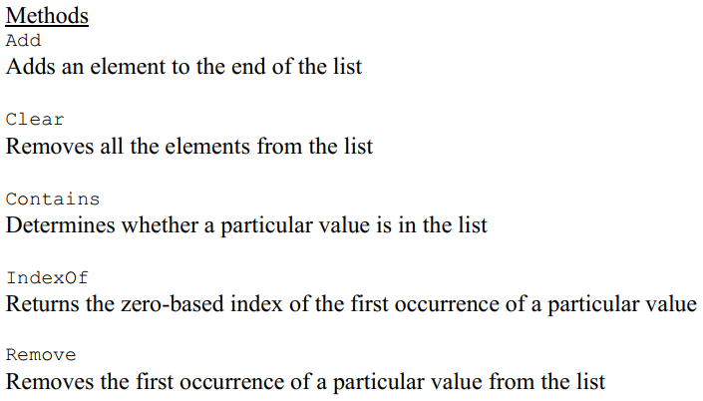

6.6 Collection Classes
Methods and Property of the List

Slide 23
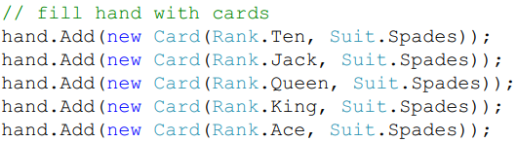
6.6 Collection Classes
To fill the hand with the 5 cards we used before:
Use the square brackets to access specific elements of the list.
There are lots of collection classes that you'll find useful as you pursue more advanced programming projects.

Slide 24
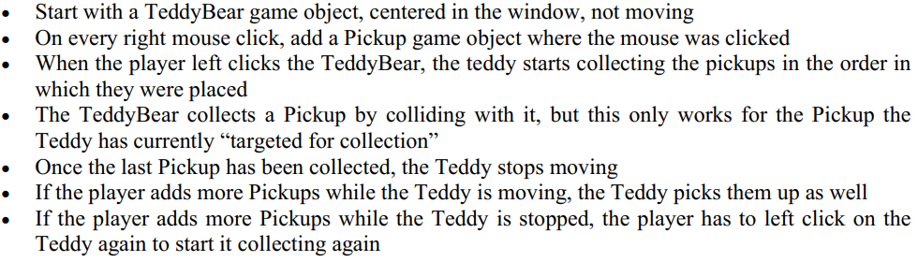
6.7 Putting It All Together
The Problem Description

Slide 25
6.7 Putting It All Together
Understand the Problem
The required program behavior should be clear, even though we have lots of other work ahead of us.
Design a Solution
A Pickup prefab and a TeddyBear prefab.
Need a TeddyBear script because the Teddy Bear game object has specific behaviors it has to perform during the game (like starting to collect pickups when the mouse is left clicked on it).
need to keep track of whether or not the Teddy Bear is currently collecting Pickups because we only want to respond to left clicks on the Teddy Bear is it's not currently collecting; that field should be a bool.
Use the Start method to make sure the Teddy Bear is centered in the screen when the game starts and the Update method to respond to left mouse clicks when they occur on the Teddy Bear.

Slide 26
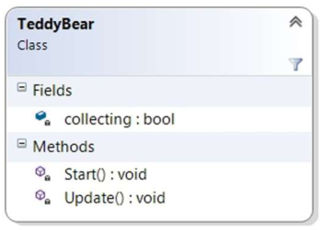
6.7 Putting It All Together
Design a Solution
TeddyBear UML

Slide 27
6.7 Putting It All Together
Design a Solution
Write a TedTheCollector script, which we'll attach to the Main Camera, to hold the list of Pickups in the game.
need a of the Pickups that are currently in the game ➔ make that a list of GameObjects.
need to keep the default Update method so we can detect right mouse clicks and add a Pickup to the game when that happens.
a TargetPickup property that returns the oldest Pickup in the game.
a RemovePickup method that removes a given Pickup from the list of Pickups and destroys that pickup to remove it from the game.

Slide 28
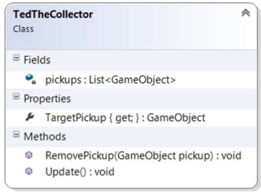
6.7 Putting It All Together
Design a Solution
TedTheCollector UML

Slide 29
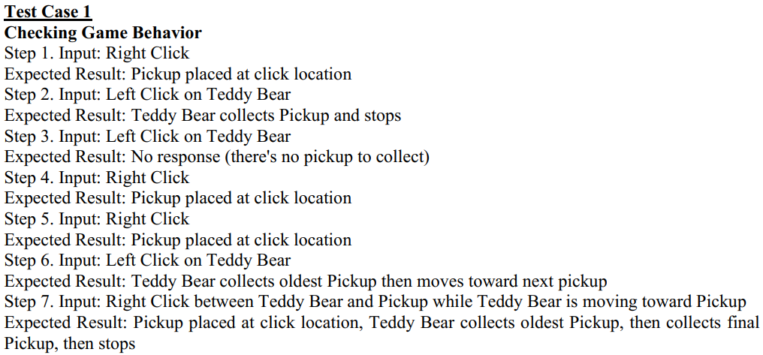
6.7 Putting It All Together
Write Test Cases

Slide 30
6.7 Putting It All Together
Write the Code
create a new Unity 2D project
save the scene into a Scenes folder
import a teddy bear sprite and a pickup sprite into a sprites folder
create an empty Prefabs folder.
build the Pickup and TeddyBear prefabs.
Drag the teddy bear sprite from the Sprites folder in the Project window and drop it in the Hierarchy window. Change the name of the game object in the Hierarchy window to TeddyBear. Create a new Scripts folder in the Project window, then create a new C# Script called TeddyBear in the Scripts folder.

Slide 31
6.7 Putting It All Together
Write the Code
Drag the TeddyBear script onto the TeddyBear game object in the Hierarchy window, then drag the TeddyBear game object from the Hierarchy window onto the Prefabs folder in the Project window.
drag the pickup sprite from the Sprites folder in the Project window and drop it in the Hierarchy window. Change the name of the game object in the Hierarchy window to Pickup. Drag the Pickup game object from the Hierarchy window onto the Prefabs folder in the Project window.
right-click the Pickup game object in the Hierarchy window and Delete it.
Create another C# script called TedTheCollector in the Scripts folder in the Project window and drag that script onto the Main Camera.

Slide 32
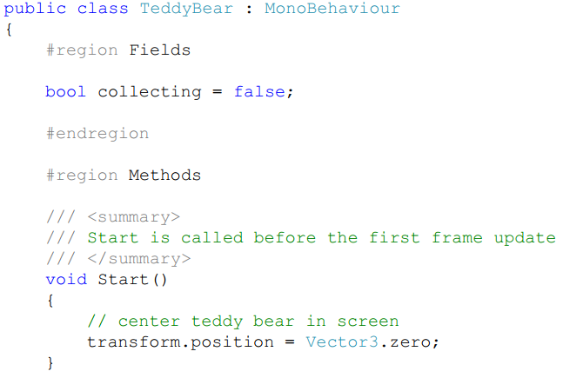
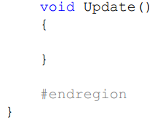
6.7 Putting It All Together
Write the Code
The TeddyBear script

Slide 33
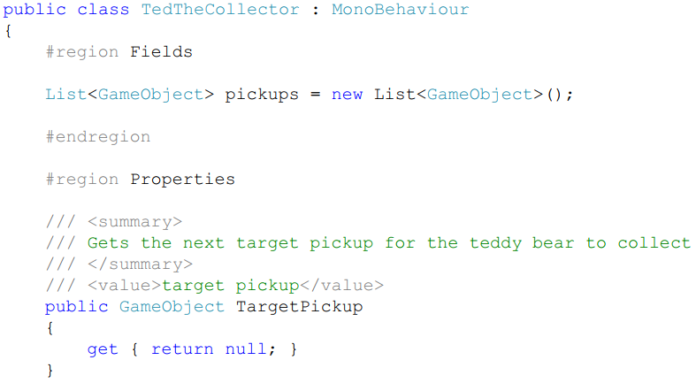
6.7 Putting It All Together
Write the Code
The TedTheCollector script

Slide 34
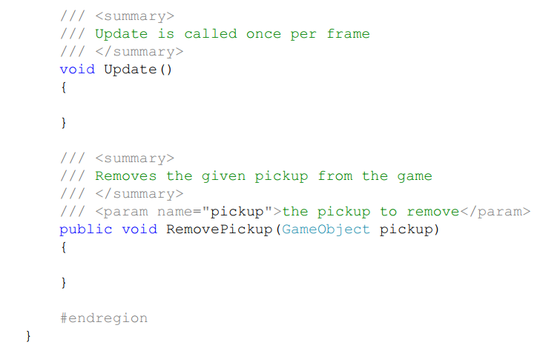
6.7 Putting It All Together
Write the Code
The TedTheCollector script

Slide 35
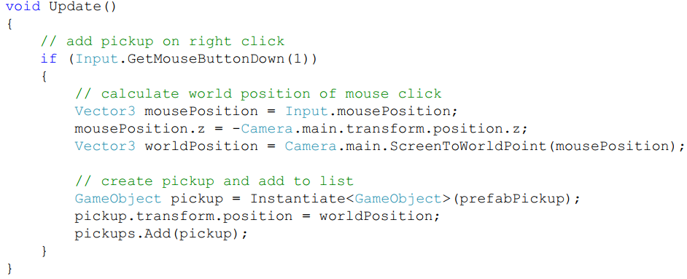
6.7 Putting It All Together
Write the Code
implement the TedTheCollector Update method

Slide 36

6.7 Putting It All Together
Write the Code
implement TargetPickup property
Because the TedTheCollector script recognizes right clicks in its Update method, our initial thought was that the TeddyBear script would recognize left clicks in its Update method. This is a little more complicated than right clicks, though, because we don't want to recognize any left click, we only want to recognize left clicks that are actually on the TeddyBear game object.
➔ instead of using the Update method for this, we should use the OnMouseDown method instead (refer to MonoBehaviour Messages (Methods) ).

Slide 37
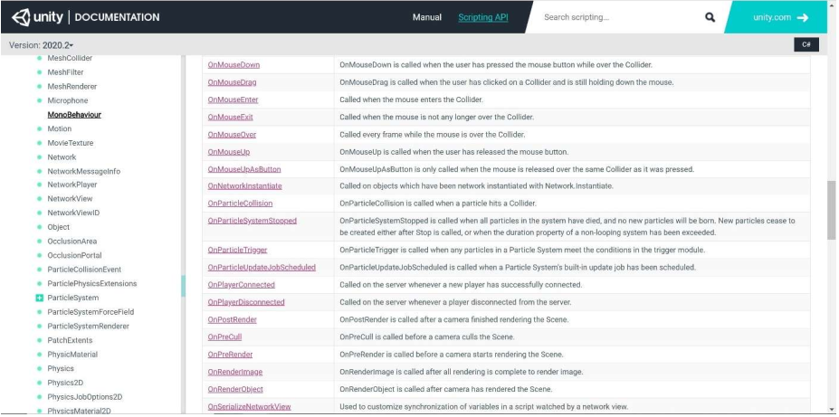
6.7 Putting It All Together
Write the Code
MonoBehaviour Messages (Methods)

Slide 38
6.7 Putting It All Together
Write the Code
delete the TeddyBear Update method
Because our TeddyBear game object doesn't have a collider component yet (which we need for OnMouseDown to be called), we'll add one now.
Double-click the TeddyBear game object in the Hierarchy window of the Unity editor; this zooms in on the game object in the Scene view. Click the Add Component button in the Inspector and select Physics 2D > Box Collider 2D. As you can see in the Scene view, the Box Collider 2D is too large because the sprite image has some border transparency. Click the button to the left of Edit Collider in the Box Collider 2D component, drag the edges of the collider in the Scene view to fit the TeddyBear game object more tightly, then click the button to the left of Edit Collider in the Box Collider 2D component again. Click the small box next to Is Trigger in the Box Collider 2D component.
sets the collider to be a trigger rather than a collider from a physics perspective.

Slide 39
6.7 Putting It All Together
Write the Code
While we're at it, we might as well add a Rigidbody 2D component to the TeddyBear as well. We're going to just use the Unity physics engine to move the TeddyBear, and we'll need a Rigidbody 2D component attached to it to do that. Click the Add Component button in the Inspector and select Physics 2D > Rigidbody 2D. Click the Overrides dropdown near the top of the Inspector and select Apply All to apply the changes to the TeddyBear prefab.
If you run the game now, the TeddyBear game object falls off the bottom of the screen. Select Edit > Project Settings > Physics 2D from the menu bar at the top of the editor and set the Y value for Gravity to 0. Run the game again to verify that you turned gravity off correctly.

Slide 40
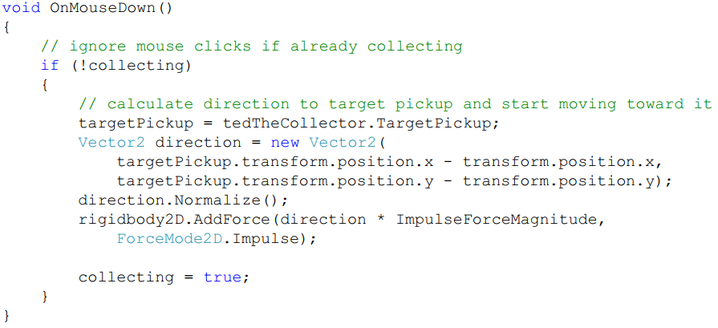
6.7 Putting It All Together
Write the Code
Add the OnMouseDown method to respond to left clicks on the TeddyBear

Slide 41
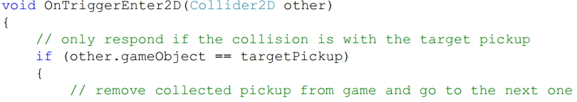
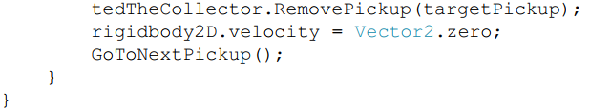
6.7 Putting It All Together
Write the Code
add an OnTriggerEnter2D method that automatically gets called when the collider for the TeddyBear (remember, we made it a trigger) collides with another collider (a collider for a Pickup game object).

Slide 42

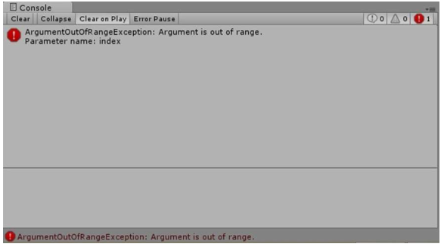
6.7 Putting It All Together
Write the Code
Implementing the body of the TedTheCollector RemovePickup method
Run Steps 1 and 2 of the test case, we get the error shown in the Console window

Slide 43
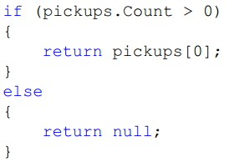
6.7 Putting It All Together
Write the Code
change the body of the TargetPickup property

Slide 44
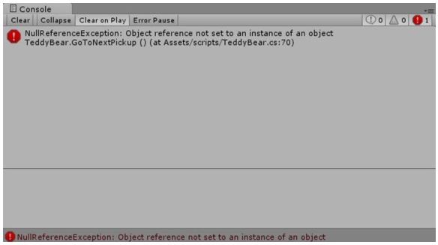
6.7 Putting It All Together
Write the Code
Run Steps 1 and 2 from the test case again; now we get the error shown below

Slide 45
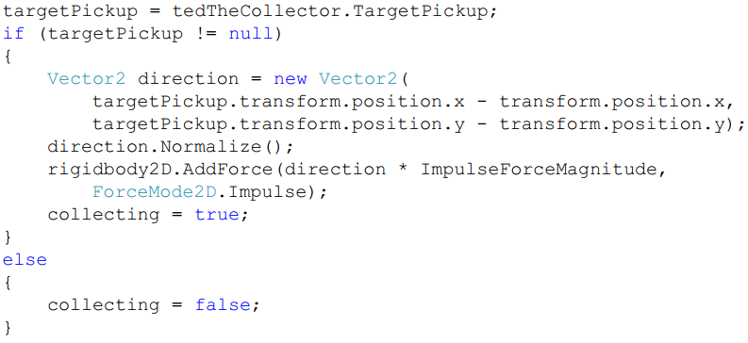
6.7 Putting It All Together
Write the Code
change the body of the GoToNextPickup method to

Slide 46
6.7 Putting It All Together
Test the Code
Try placing two pickups close to each other, with the first pickup further away than the second one, then click the teddy bear and watch what happens. Why does the teddy bear pick up the first pickup but not the second one?
Before we fix the bug, we now have another test case we should include in our test plan, so we'll add that now.

Slide 47
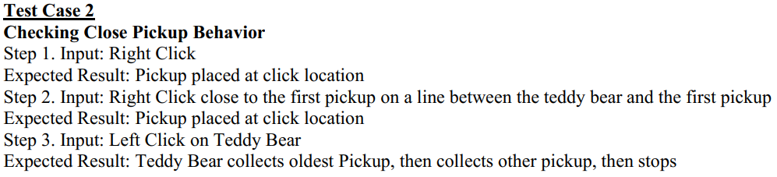
6.7 Putting It All Together
Write Test Cases (again)

Slide 48
6.7 Putting It All Together
Write the Code (again)
use the debugger again to try to figure out what's going on. We know that the teddy bear actually picks up each pickup in the TeddyBear OnTriggerEnter2D method.
Change the TeddyBear OnTriggerEnter2D method to an OnTriggerStay2D method instead.

Slide 49
6.7 Putting It All Together
Test the Code (again)
both test cases complete successfully
We're not quite happy, though; read on.
Understand the Problem (again)
add one more explicit requirement to the Problem Description: The TeddyBear passes over Pickups it collides with that aren't the Pickup the Teddy has currently “targeted for collection”.

Slide 50
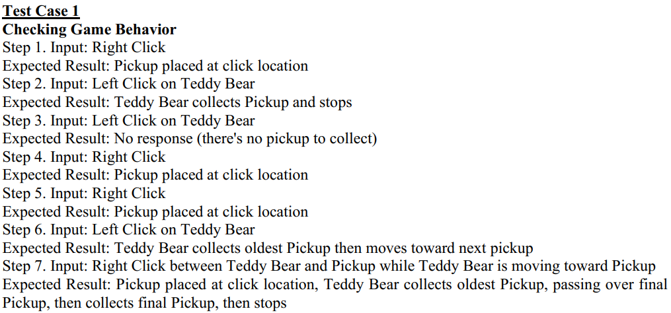
6.7 Putting It All Together
Write Test Cases (for the third time)

Slide 51
6.7 Putting It All Together
Write the Code (for the third time)
We don't actually have to change our scripts at all, but we do have to make some changes in the Unity editor.
We need to understand two more Unity features: Sorting Layers and Order in Layer.
In Unity, we can place objects in different sorting layers to control the order in which the sprites are rendered in the scene. The template Unity 2D game project only contains a single sorting layer called Default. If you select the TeddyBear and Pickup prefabs and look at the Sorting Layer value in the Additional Settings section of their Sprite Renderer components, you'll see that they're both set to Default; that means both of them will be drawn when the sprites in the Default sorting layer are drawn.

Slide 52
6.7 Putting It All Together
Write the Code (for the third time)
➔ add a new Sorting Layer to the project by selecting Edit > Project Settings > Tags & Layers. Expanding the Sorting Layers section in the Inspector shows all the sorting layers in the game. To add a new sorting layer, we'd click the + at the bottom right of the list of sorting layers. The sorting layers are rendered back to front from the top of the list, so if we name our new sorting layer TeddyBear all the sprites in the Default sorting layer would be rendered first, then all the sprites in the TeddyBear sorting layer would be rendered. If we went back to our TeddyBear prefab and used the Sorting Layer dropdown in the Sprite Renderer component to assign the TeddyBear sorting layer, our TeddyBear game object would be drawn in front of everything else (including Pickup game objects, which are still in the Default sorting layer).

Slide 53
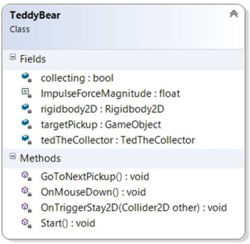
6.7 Putting It All Together
Test the Code (for the third time)
Both test cases pass successfully.
TeddyBear Final UML

Slide 54
Exercise 22: Lists
View LMS

Slide 55
6.8 Common Mistakes
Indexing Past the End of the Array
if our array indices go from 0 to 9 and we try to look at element 10, C# will throw an ArrayIndexOutOfBoundsException
Indexing Outside the Contents of a Collection
If we try to return the first pickup from an empty list of pickups, C# will throw an ArgumentOutOfRangeException.
Trying to Read or Print the Entire Array at Once
Remember, arrays are actually objects, and you have to read or print each element of the array separately.
Forgetting to Create Objects in Array or Collection
If you forget to actually create the objects within the array or collection, C# will throw a NullReferenceException when you try to access properties or methods of any of those array or collection elements.

